Slide 1

Sales Forecasting
Khwaja Jalal Sediqi

Slide 2

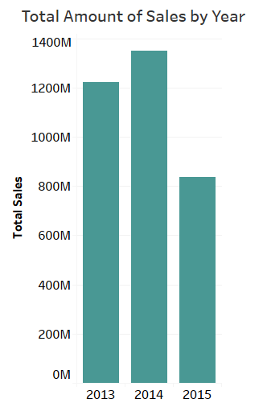
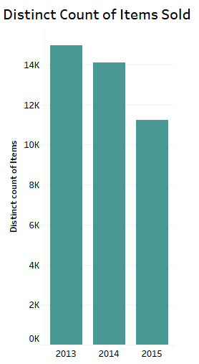
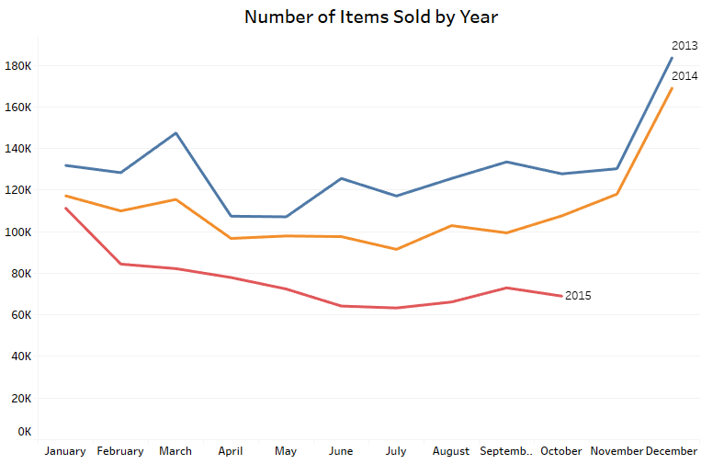



The total amount of sales increased, however, there is no complete data for 2015’s sales.
The Variety of items or the number of distinct items decreased from 2013 to 2015. However, the total number of items sold did not decrease over time.

Slide 3
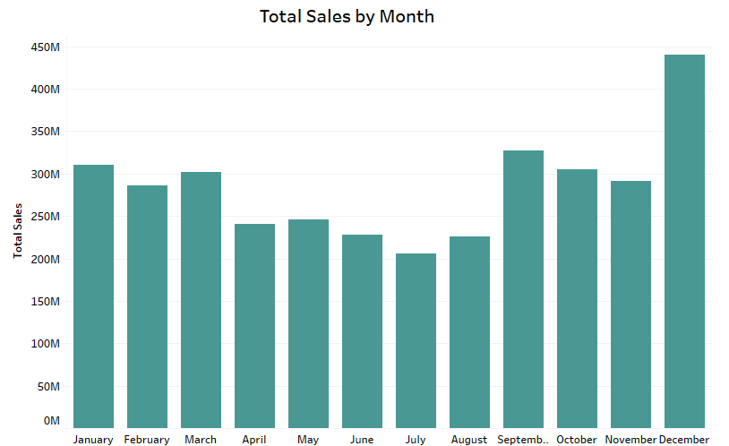
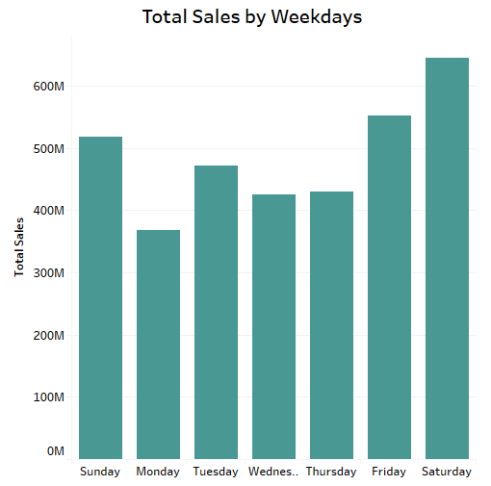
The last four months has the highest amount of sales. December is significantly high because of Christmas.
Weekend including Friday has the highest amount of sales compared to weekdays.

Slide 4
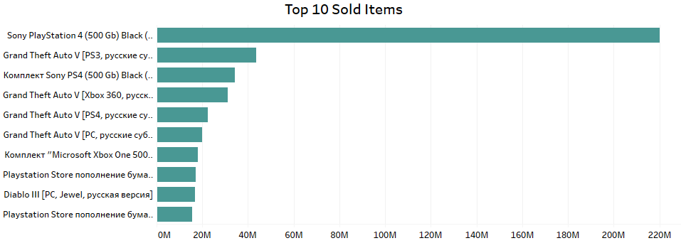
All of the top 10 sold items are game related like PS3, PS4, Xbox. However, Sony Play Station has the highest amount of sales with more than 200 millions.

Slide 5
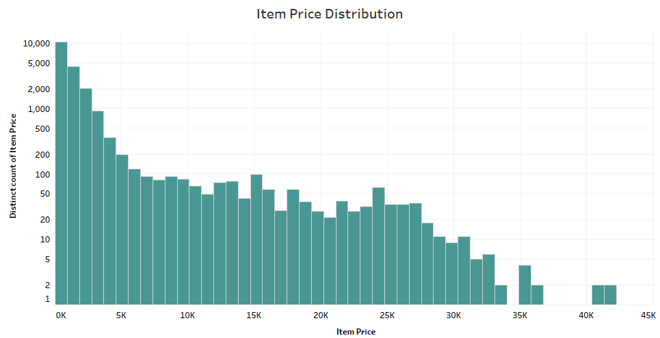
77 Percent of all the items are below $1000.
The average item price is $890.

Slide 6
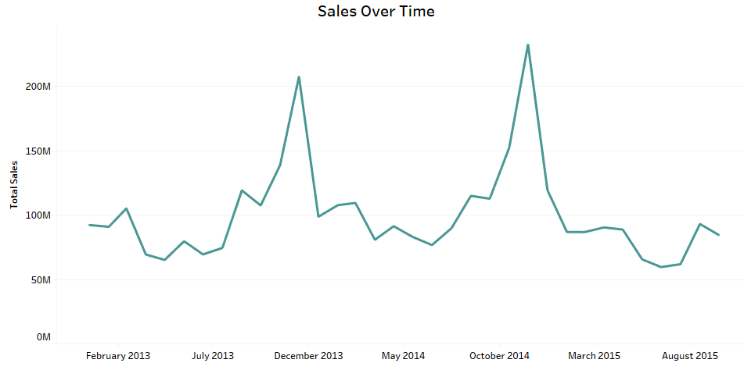
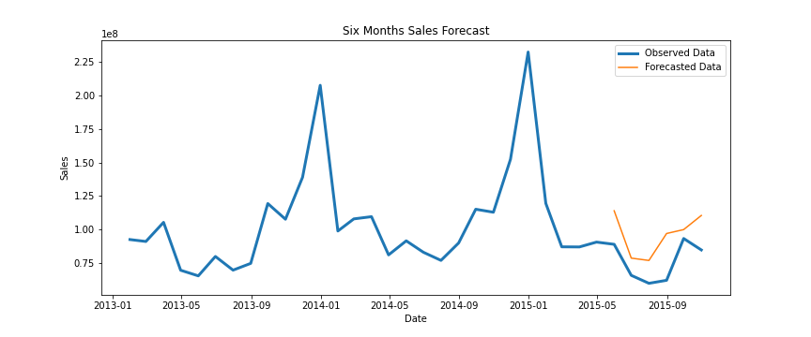
The last six months of data set are May – October, and the sales are at the lowest during the year at this period.
After running a time series forecasting model on the monthly sales data, the forecasting results from the model was 70% accurate.

Slide 7
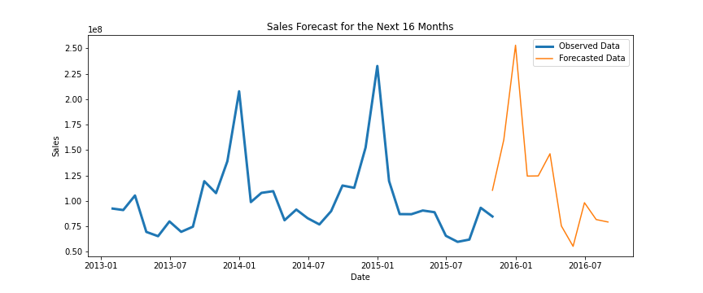
The forecasted data mostly follows the same pattern as historical data, so the forecast can be considered satisfactory.

Slide 8
Recommendations
Next Step
3722 items are discarded from sales list. Replacing the discarded items with new items would increase the sales.
The forecasted sales for next two months, i.e. November and December are increasing.
Creating a time series model containing all the potential features in the data.

